Slide 2
Project Title
Playlist Manager Using Fisher-Yates Shuffling Algorithm & Sorting
Project Guide
Ravi Singhal

Slide 3
Prepared By
Specialization | SAP ID | Name
B.Tech CSE AIML | 500076373 | Ishika Kesarwani
B.Tech CSE AIML | 500075359 | Niharika Agrawal
B.Tech CSE AIML | 500076519 | Prabhraj Singh
B.Tech CSE AIML | 500075307 | Pradumn Nathawat

Slide 4
Introduction
Shuffling may be a method employed to randomize a knowledge set to make sure a component of chance when elements from the info set are selected randomly. Literature has established that computers are capable of generating a perfect shuffle; Shuffling is additionally widely utilized in music players as a separate feature allowing listeners to randomize their playlists. However, a perfect or bias-free shuffle may be counter-intuitive during this case as even in randomized selections, listeners tend to possess inclinations towards a particular sort of song depending on their mood. Via this project, we propose a predictive playlist manager which will provide automated dynamic-based shuffling consistent with the user's preferences. This shuffling takes under consideration various parameters like genre, artist, play duration, and release date and selects subsequent songs thereon a basis.
Listening to the same song repeatedly is often extremely boring and aggravating. Thus shuffling songs within the playlist is a crucial task and will tend to be of considerable weight. Ideal Shuffling may be a procedure wherein the songs are randomly ordered with no preference to a song or following any particular order of placing influenced by the history of the user, during this case songs present in the playlist may or may not be of the users liking. By consciously selecting the playlist according to the songs that are currently playing, we try to provide the user with a one-of-a-kind musical experience.
A few of the shuffling algorithms are Faro’s Shuffle, the Fisher-Yates Shuffle (Knuth shuffle) Algorithm Amongst all the shuffling algorithms, the Fisher-Yates Shuffle (Knuth shuffle) Algorithm is that the most optimal and widely used algorithm. A lot of research has been done and remains to be done in order to enhance the Fisher-Yates Shuffle Algorithm and it's been applied to varied real-world applications.
keywords: Artist, Album, Genre, Release Date(whether a same decade or not)

Slide 5
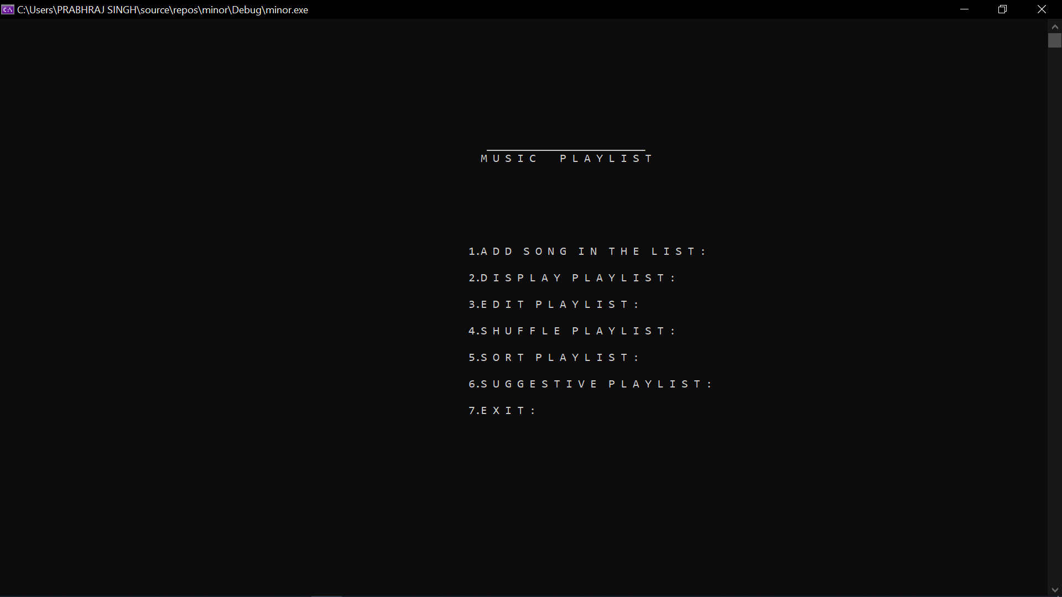
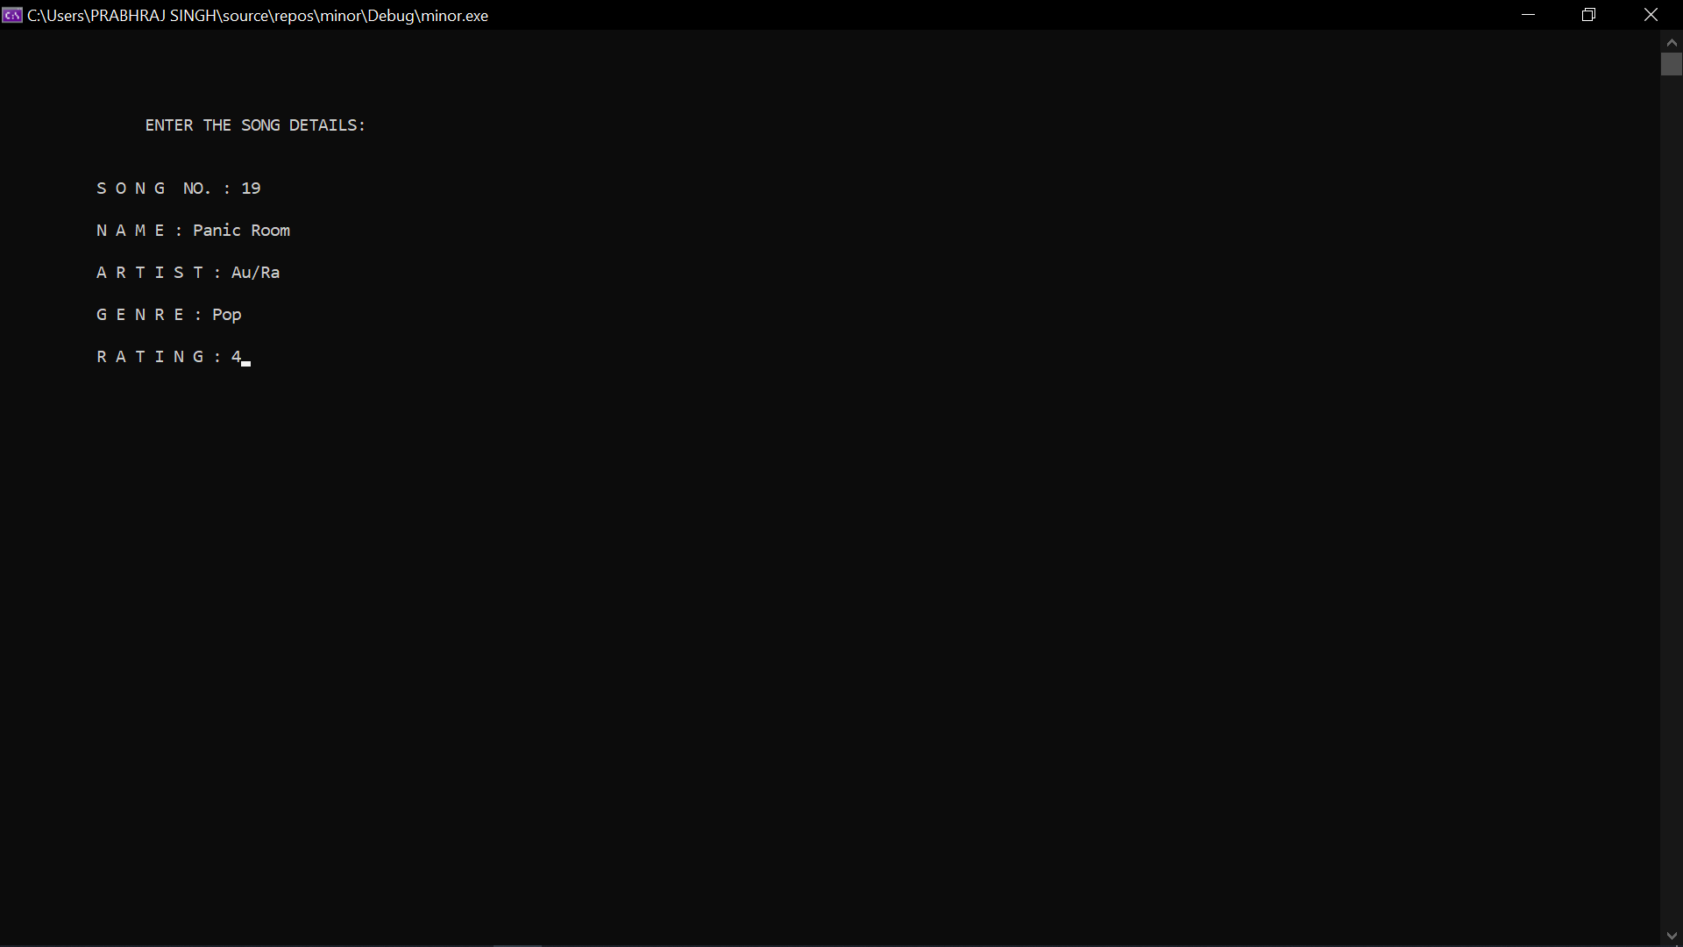
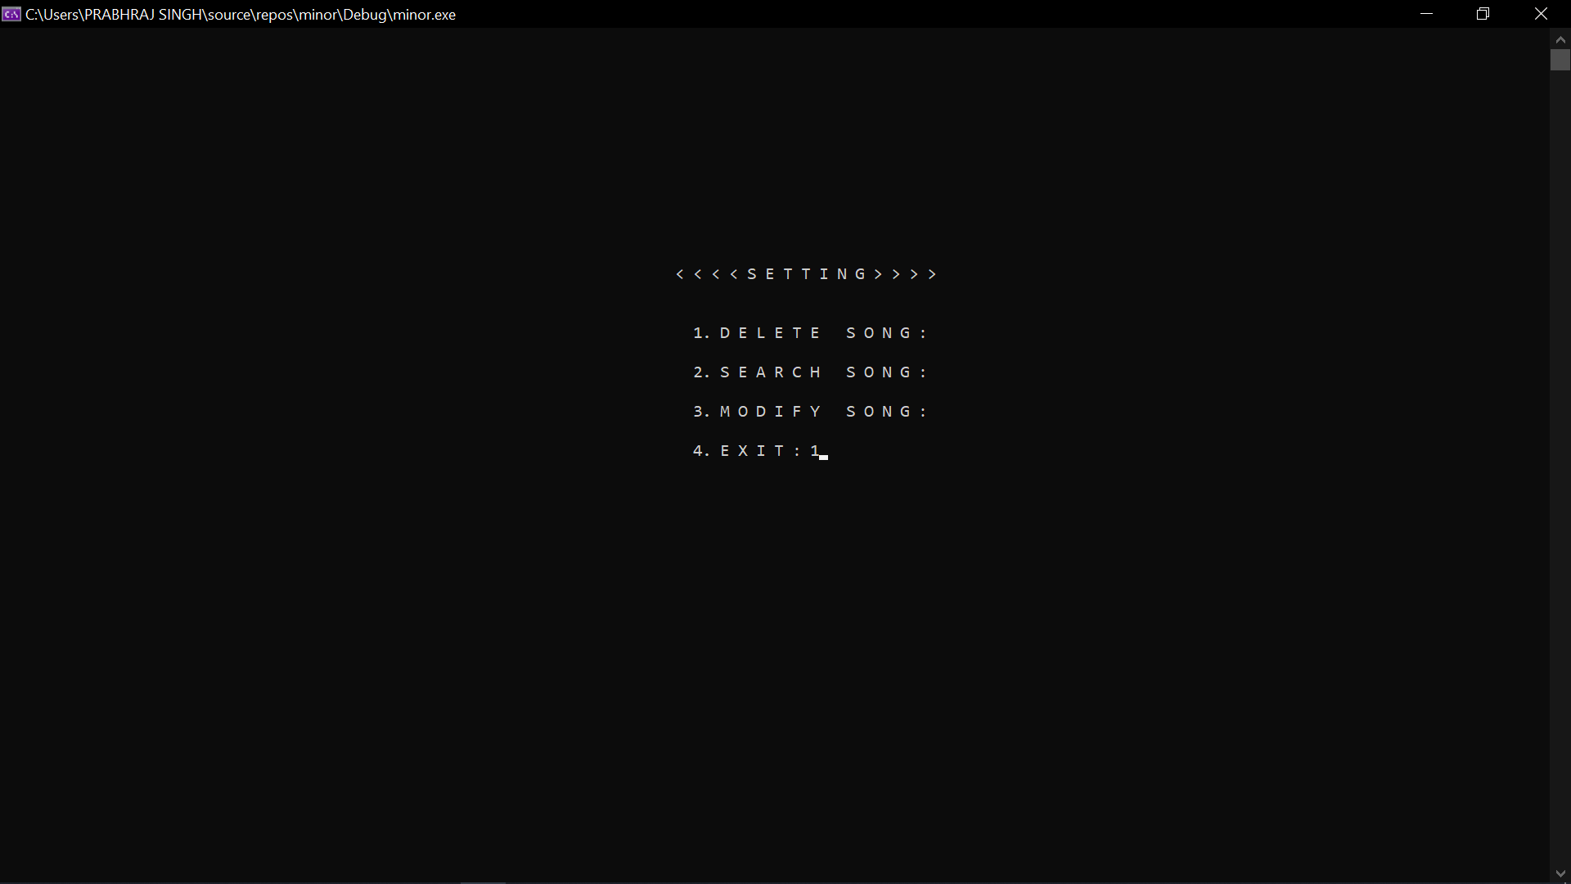
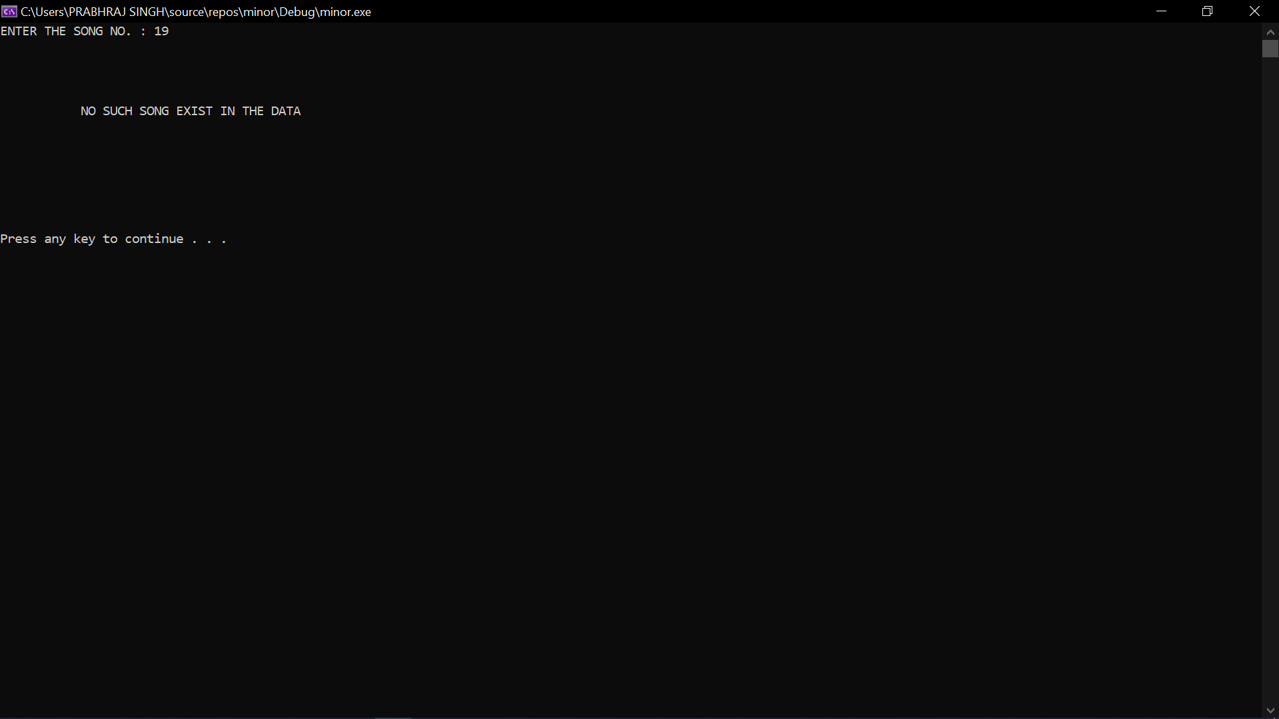

Slide 6
Literature Review
• Fisher yates algorithm produces an unbiased permutation: every permutation is equally likely. The modern version of the algorithm is efficient: it takes time proportional to the number of items being shuffled and shuffles them in place. The asymptotic time and space complexity of the Fisher–Yates shuffle are optimal. Combined with a high-quality unbiased random number source, it is also guaranteed to produce unbiased results. Shuffling may be a method employed to randomize a knowledge set to make sure a component of chance when elements from the info set are selected randomly. Literature has established that computers are capable of generating a perfect shuffle; Shuffling is additionally widely utilized in music players as a separate feature allowing listeners to randomize their playlists. However, a perfect or bias-free shuffle may be counter-intuitive during this case as even in randomized selections, listeners tend to possess inclinations towards a particular sort of song depending on their mood. Via this project, we propose a predictive playlist manager which will provide automated dynamic-based shuffling consistent with the user's preferences. This shuffling takes under consideration various parameters like genre, artist, play duration, and release date and selects subsequent songs thereon a basis. The Fisher-Yates Shuffle (Knuth shuffle) Algorithm is that the most optimal and widely used algorithm. A lot of research has been done and remains to be done to enhance the Fisher-Yates Shuffle Algorithm and it's been applied to varied real-world applications.

Slide 7
Problem Statement
Making the music playlist foresighted based upon the user’s preference using Fisher-Yates Algorithm. So, the songs will be fetched from the playlist and would be displayed on the screen in a shuffled manner.

Slide 8
Motivation
“There is always an element of poetry in science. Real science and real music requires a uniform thinking process.” - Albert Einstein
Nowadays everyone tends to listen to music while doing their work and because of this they may make or use a playlist based on different tasks they do in their whole day or based on whatever they are feeling at the moment. Reports and research suggest that listening to the same music repeatedly can cause a person to go into depression and may push him to hate music and to give up on music itself. As we realize that change is critical in life and is beneficial also. Consequently, the change of the music being heard by an individual is similarly important. Smart Shuffling is useful when a single playlist for different genres is created by the user and the user listens to the song that gives them the vibe of what they are aiming for since it suggests on the basis of what genre the user is listening to and what genre he is trying to avoid at the moment. That’s why shuffling a music playlist based on the user's particular choice is very important to achieve the goal the user has set while listening to the playlist.

Slide 9
Objectives
To make a Smart Music Playlist system which will be User-friendly by making it easier for the users to use the project and perform functionalities like, adding searching, modifying a song, etc
By making it a Smart Music Playlist system, which will be automatically creating Playlists according the user’s preference, be it be Randomly shuffled, or Sorted, or a Predictive one according to the song’s Rating.

Slide 10
Methodology
In this project, we will first start off by creating a playlist for the user, by making a class song with attributes with name, genre, and duration. For this we will be using File handling having a single file corresponding to each of the song names, the artist’s name and all the other details related to the song will also be there in the database.
The user can add, delete, shuffle, sort, search for a song at any time, and index in the playlist. In this, class “Song” will be made for each song having functionality that will dump the data in the database.
In this, they can shuffle the playlist using the Fisher-Yates algorithm. We will try to make the playlist foresighted based upon the user’s preferred genre and time. So whenever the fisher yates algorithm will be called the songs will be fetched from the binary file/CSV file and would be displayed on the screen in a shuffled manner.
Fisher-Yates Algorithm is used to generate a random permutation of array elements. Here shuffle means that every permutation of array elements should be equally likely. In simple language, the functionality of the algorithm in this project is to randomly pick out songs, until there is no song left in the playlist. Fisher-Yates Shuffle algorithm can be described as-
To shuffle an array a of n elements (indices 0..n-1):
for i from n - 1 downto 1 do
j = random integer with 0 <= j <= i
exchange a[j] and a[i]

Slide 11
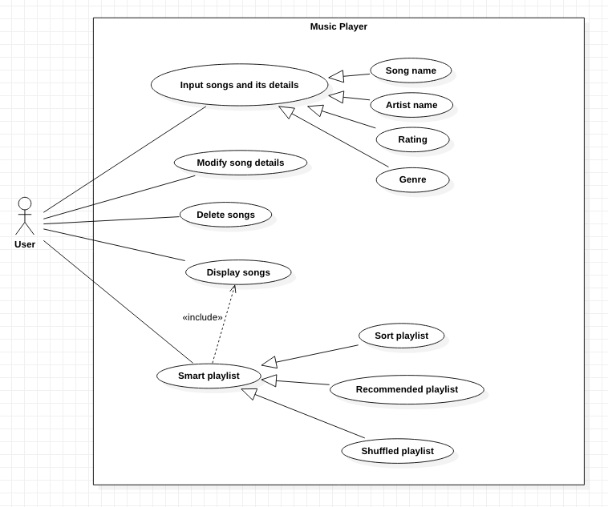
Class Diagram/UML/Use Case/DFD etc.,
Figure: 1.1 (Use Case Diagram)

Slide 12
Algorithmic approach / Learnings
Fisher-Yates -
Made use of the Algorithm, to shuffle the songs, from an array of integers, return a shuffled version of the array (its design problem). All permutation of the array should be equally likely as a result of the shuffling.
File Management System -
A file system is the data structure designed to support the abstraction of the data blocks as an archive and collection of files. In other words, a file system organizes the data blocks into files, directories, and file information. This data structure is unique because it is stored on secondary storage (usually the disk), which is a very slow device. We are using Binary File as it provides a better security and contains bytes or a compiled version of a text file. Binary File takes a lot less space compared to text files.

Slide 13
References & GIT link
https://uxdesign.cc/randomly-not-random-2fd53536513c
"Probably perfect shuffle algorithms". Oleg Kiselyov. 3 Sep 2001. Retrieved 2013-07-09.
https://www.geeksforgeeks.org/shuffle-a-given-array-using-fisher-yates-shuffle-algorithm/
https://youtu.be/81z5a4StXHM https://spotifyshuffler.com/Home/About
https://dev.mysql.com/doc/connector-cpp/8.0/en/

